Slide 1


Medicaid Monthly Virtual Meeting
Dec. 18, 2025

Slide 2

Agenda
Welcome/Introduction
Medicaid Renewals and State Based Marketplace Updates
Our Healthy Kentucky Home Campaign Spotlight – kynect
1915(i) RISE Initiative
1915(c) Community Health for Improved Lives and Development (CHILD) Waiver
TEAMKY 1115 Update
House Resolution 1 (119th Congress)

Slide 3
Medicaid Enrollment Trend
3
Notes:
Talking Points:
This slide is the most current look at Medicaid enrollment. As we shared before, this was an anticipated decline from the beginning of 2023 following the PHE unwinding. We have worked through all the initial renewals following the PHE and so now you can see that we are now hovering around 1.45 million. This has been holding steady.

Slide 4
Medicaid Renewals – November 2025
 | Individual Renewals | Medicaid Approvals | Medicaid Terminations | Pending
November | 61,033 | 51,827 | 3,675 | 4,590
*Numbers are based on CMS Reports.
4
Notes:
Talking Points:
- Here is a summary of Medicaid renewals for the month of November: A total of 61,033 renewals were processed, resulting in 51,827 approvals, 3,675 terminations, and 4,590 cases remaining pending.

Slide 5
November 2025 Renewals By Age
5
Notes:
Talking Points:
- Next, we will examine renewals broken down by age for the month of November.

Slide 6
November 2025 Child Renewals
6
Notes:
Talking Points:
Let’s take a closer look at the children’s renewal process now that flexibilities have ended. The Blue bar indicates Approved and Orange indicates Terminated. This analysis provides insight into approval and termination outcomes when comparing passive and active renewals.
Active renewals require the enrollee to take action by submitting updated information or documentation to verify continued eligibility. Failure to respond can result in termination of coverage.
Passive renewals, on the other hand, are processed automatically using existing data sources. Within passive renewals, there are two types:
Passive renewals with No Request for Information (RFI): The state is able to verify continued eligibility using existing data without needing any additional information from the household.
Passive renewals with an RFI: Although the renewal is initiated passively, the state determines that additional information is needed to confirm eligibility. In this case, a request for information is sent to the household, and failure to respond can lead to termination.
Understanding the differences between these renewal types helps clarify the trends in coverage retention and disenrollment as flexibilities have ended.

Slide 7
November 2025 Child Terminations by Reason
7
Notes:
Let us review the breakdown of termination reasons for children’s November renewals, which encompass ages 0–18. A total of 1,479 cases were terminated due to failure to return renewal paperwork or verification. An additional 431 cases were deemed ineligible for benefits, which may be attributed to factors such as income exceeding program limits, relocation out of state, access to alternative insurance coverage, or other eligibility changes. Finally, 393 cases were terminated for miscellaneous reasons such as client request.

Slide 8
Stay Covered: Renew Your Medicaid!
Every 12 months Medicaid members will go through a renewal process to make sure they are still eligible for coverage. Keep your information updated!
A renewal notice is sent at least 45 days before the due date with instructions and a deadline to submit required information. A reminder is sent about 15 days before due date.
You can check your renewal month by logging into the Kynect portal or calling the Kynect line. kynect.ky.gov or call 855-4kynect (855-459-6328). Providers also have access to the renewal date in KYHealthNet.
Send in requested information right away to avoid losing coverage! If coverage is terminated, reach out within 90 days to submit information to reactivate the case. If outside the 90 days will need to reapply.
8

Slide 9

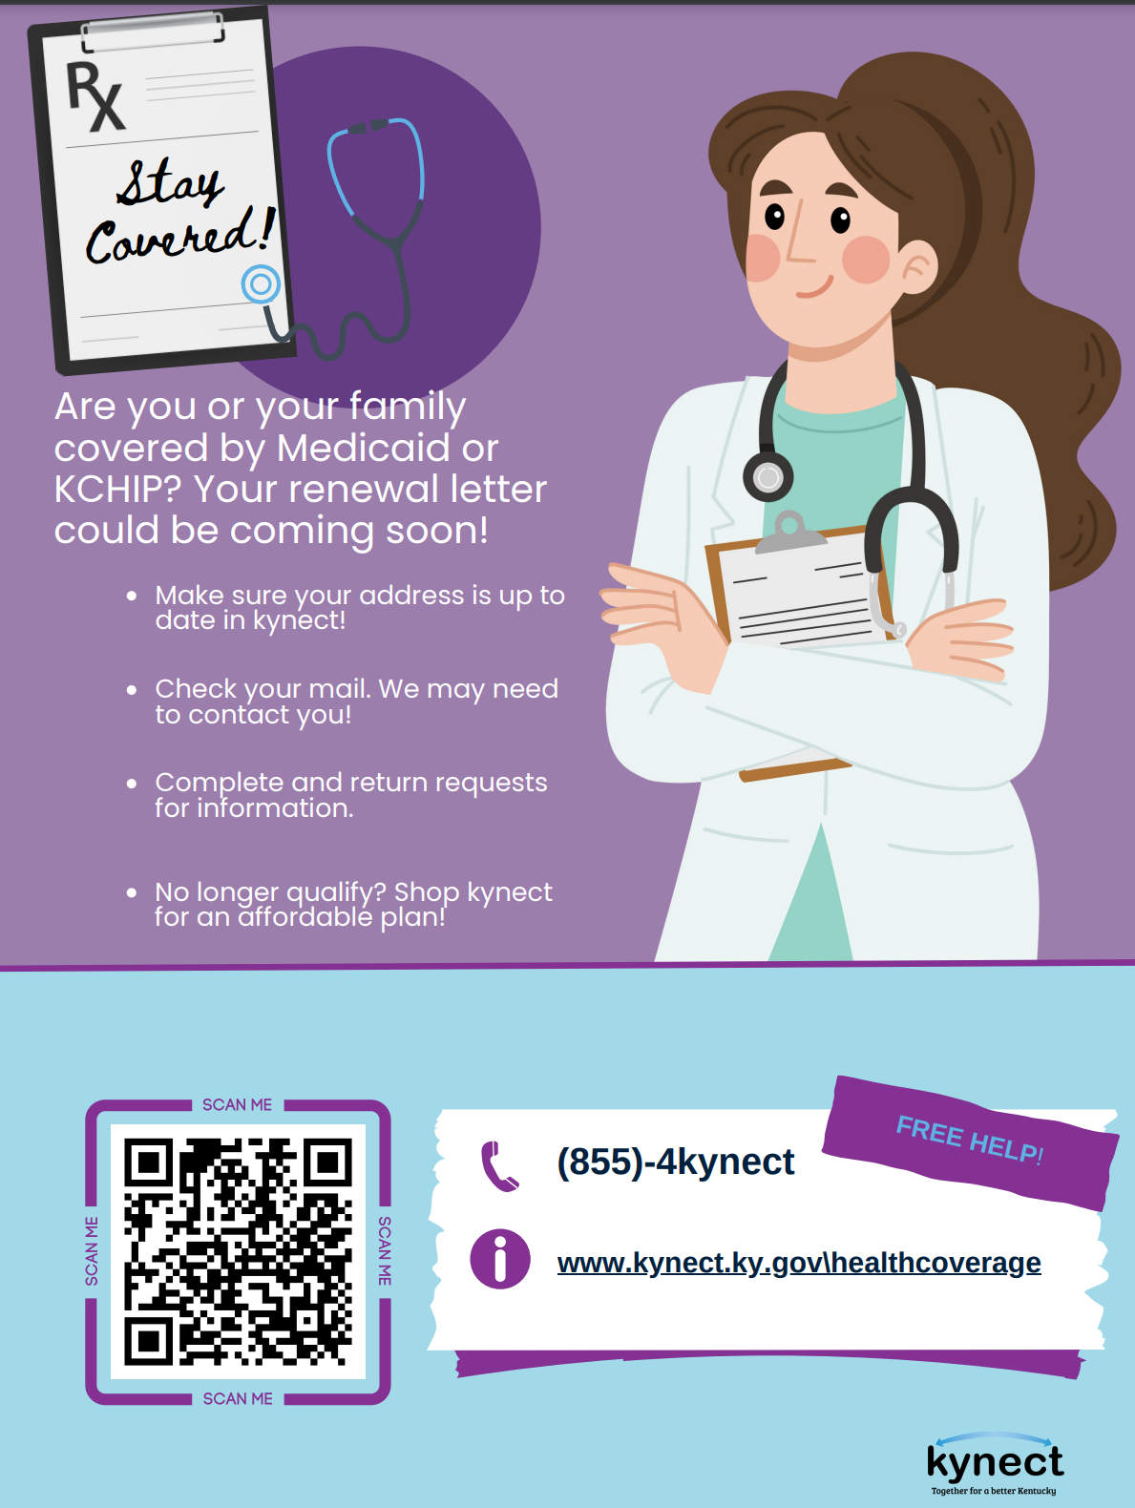
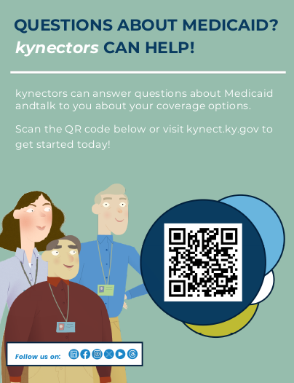
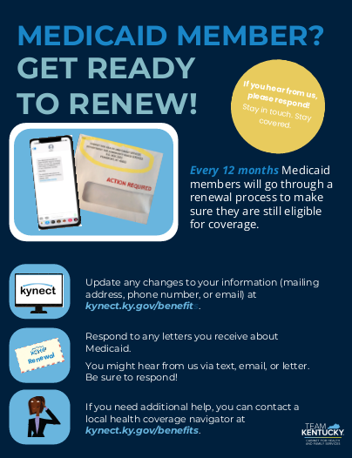
Help us get the message out! Communications materials available to support members!
How to Apply
Materials for Offices
Get help from kynectors
Renewals
9
https://medicaidrenewals.ky.gov

Slide 10
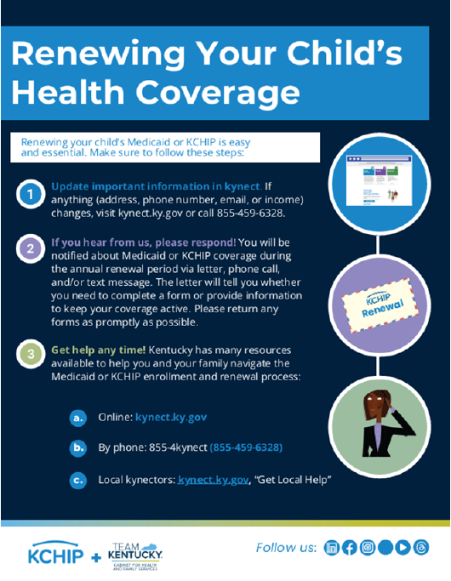
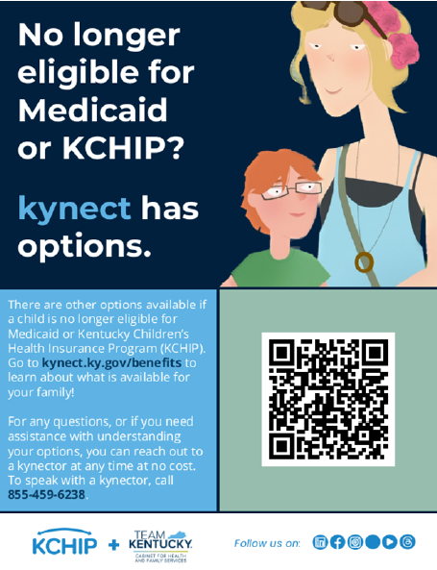


Spread the word about Renewals for Children too! Materials are available to help families stay in the know!
Renewing Child Coverage
Health Coverage Options
Get help from kynectors
Use kynect
https://kidshealth.ky.gov/Documents/Child%20Renewal%20Communication%20Packet_April%202025.pdf
10

Slide 11

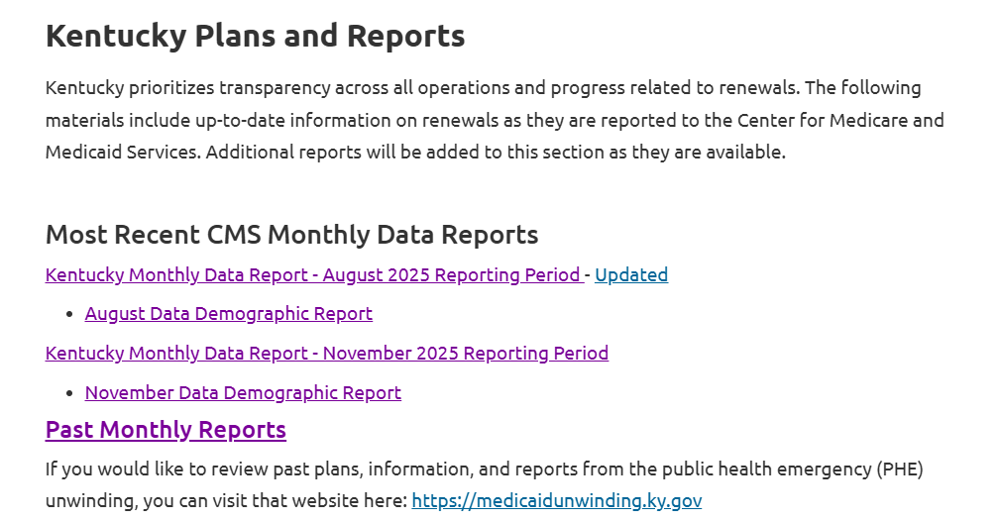
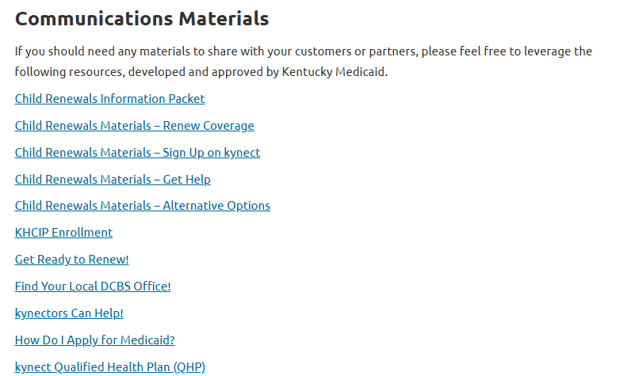
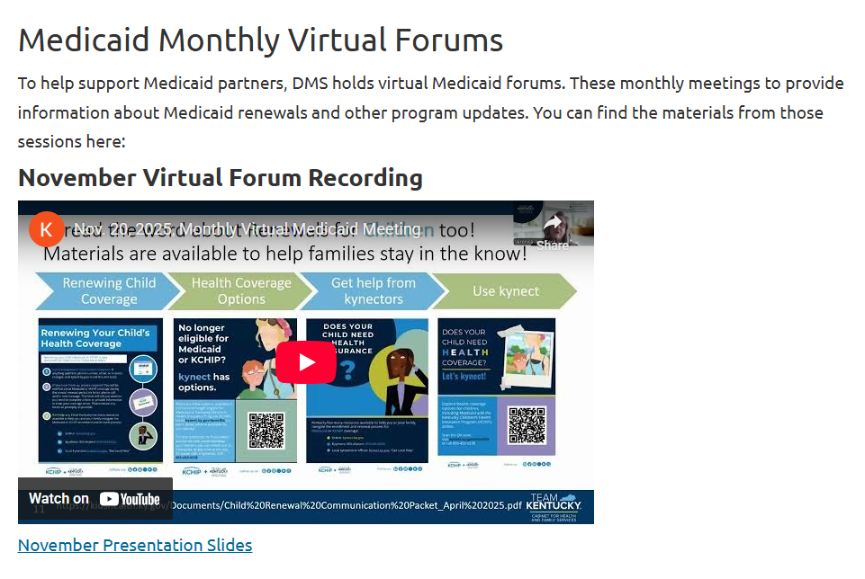
KY Medicaid Website Resources
https://medicaidrenewals.ky.gov
Monthly Forum Session Information
KY Reports
FAQs
Medicaid Member Information
Medicaid Provider Information
Communication Materials
11
Notes:
Talking Points:
We also always remind folks that there is a lot of information on that website!
There are fliers for navigating the renewal process, helping members with things like ID proofing for kynect accounts, and materials for providers and kynectors to download and use.
Anyone should feel free to take these and use them to help others learn more.
Here is a snapshot of the website. It has the reports, like we mentioned, the fliers, and additional information pieces that can be useful!

Slide 12


Slide 13
State Based Marketplace Updates
Last year, 97,000 Kentuckians selected a Qualified Health Plan through the state-based health insurance marketplace. Currently, there are around 90,000 individuals enrolled in 2025 coverage. Comparatively, over 86,000 people have enrolled for 2026, including those automatically re-enrolled and people enrolling for the first time. Over 9,300 are new enrollees. To date, around 8,400 have cancelled their 2026 coverage. (More have newly enrolled than cancelled for 2026) Around 14,000 people have changed their plans—mostly from Silver to the less expensive Bronze. 5,900 of the 11,000 members who lost CareSource (left the KY Marketplace) for 2026 have come back and enrolled in a new plan from a different carrier

Slide 14
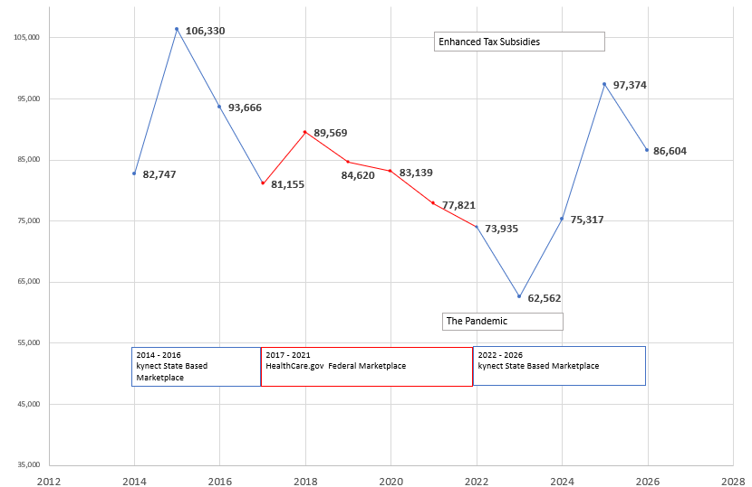
Kentuckians Enrolled in Qualified Health Plans

Slide 15

Find a plan that is truly comprehensive and certified to be compliant with the Affordable Care Act

Slide 16
State Based Marketplace More Information
Kentucky Health Benefit Exchange Homepage Facts and Resources Buyer Beware: What to know before buying a Health Plan New for 2026 Health Savings Accounts (HSA) Value of Health Insurance Brochure Calendar of Events—come out and talk with a kynector and enroll

Slide 17
Our Health Kentucky Home Campaign Spotlight: kynect

Slide 18



Year 2
We will continue to promote simple, healthy lifestyle changes with a special focus on helpful health and wellness programs available to all Kentuckians throughout the commonwealth

Slide 19


Slide 20

Kynect makes it easy to find the coverage and support your family needs- from health insurance and Medicaid to food, childcare, and housing resources.
Kynect is real help for real life.

Slide 21

Healthy Food
Families can find food assistance options
As well as local resources to stay nourished and supported

Slide 22


Slide 23


Slide 24

Notes:
Kynect may be able to help! Through the kynect benefits page, you can search and apply for many different types of Kentucky assistance programs to see if you qualify

Slide 25

Through the kynect benefits page, you can search and apply for many different types of Kentucky assistance programs to see if you qualify.

Slide 26


Slide 27
1915(i) RISE Initiative

Slide 28

~1915(i) RISE Initiative~
New Medicaid benefit under Kentucky’s 1915(i) State Plan
Designed for Medicaid-eligible adults (18+) with Serious Mental Illness (SMI), with or without a co-occurring Substance Use Disorder Brings 10 essential Home and Community-Based Support (HCBS) services to participants in their community
Notes:
Good morning! I’m TLD and part of the 1915(i) RISE Initiative with Department for Behavioral Health, Developmental & Intellectual Disabilities (DBHID).
1915(i) RISE Initiative is a joint effort of DMS and DBHDID, and focuses on helping individuals rise above their challenges through services that promote Recovery, Independence, Support and Engagement in the community.
Since I think most folks here are already aware of the program, I’ll just give a quick overview, but I’m happy to answer any questions.
The 1915(i) RISE Initiative is a new Medicaid benefit under Kentucky’s 1915(i) State Plan Amendment. Although similar to 1915(c) waivers, it is distinct as an amendment to the State Plan, and has no limit on the number of participants served. Participant services will be direct billed to Medicaid, not thru MCOs.
1915(i) RISE is designed for Medicaid eligible adults (18+), with Serious Mental Illness (SMI), with or without a co-occurring Substance Use Disorder (SUD). We’ve had some hospital inquiries about referrals, plus families, guardianship, etc. Until we are able to accept participant referrals, you may send an email to 1915iRISEInitiative@ky.gov and we will add your/the participant’s name to our contact list for later follow-up.
All participants will be pre-screened and assessed to determine needs and services, then select a case manager from a list of approved providers on BHDID’s webpage.
The case manager then assists the participant to access the other recommended services.
The program offers 10 essential Home and Community-Based Support (HCBS) services, delivered in communities, each with specific eligibility and service requirements:
1. Assistive Technology
2. Case Management
3. Housing & Tenancy Supports*
4. In-Home Independent Living Supports*
5. Medication Management
6. Planned Respite for Caregivers
7. Supervised Residential Care*
8. Supported Education
9. Supported Employment
10. Transportation
Specific service requirements are detailed in Kentucky Administrative Regulations, Title 907, Chapter 16. Participants receiving any of the housing services must be: homeless, at-risk of homelessness, formerly homeless within the prior 24 months, or now residing in HUD assisted housing; and have a history of frequent nursing home/inpatient stays. They may be preparing to exit an institutional setting.
Services can be received along with other complementary programs like AOT, as long as they aren’t duplicative.
The provider’s journey includes:
The CEO completes an initial on-line orientation and submits a Certification Application packet.
DBHDID reviews the completed Certification Packet submission and provides feedback and technical assistance, followed by notice of an initial decision on proceeding with the pending application within 10 business days of receipt
While DBHDID conducts a more extensive review of the provider’s operation, including staff credentials and experience, service alignment with fidelity model, and business documentation (e.g., Tax ID, licensure, etc.), and a site visit, the CEO completes more focused online training.
Once approved for certification, providers will enroll in Medicaid (either as a new provider or adding Provider Type 51) and Therap (the 1915(i) RISE data system) and begin extensive online staff training.
Approved providers will be added to DBHDID’s online Provider Directory and be eligible for selection by participants.
After participant services are commenced, the provider will participate in the Continuous Quality Improvement process.
The participant’s journey will include:
Anyone can contact the 1915(i) RISE program on behalf of a potential participant (family, clinician, self). They can be referred at any time, but the assessment may not be completed while the individual is residing in a facility.
Once a referral is received, an intake specialist will complete an eligibility screening via telehealth to ensure Medicaid eligibility, qualifying diagnoses, and housing status.
A trained assessor will meet with potential participants at a convenient location or via telehealth, to conduct an extensive functional assessment. This process will take a number of hours to complete, and may be spread out over a few days. Supporting documentation may be requested from the individual, previous providers, or others.
Once the participant receives notice of approval for services, program staff will assist them in choosing a case manager from available certified providers.
The case manager will collaborate with the participant to jointly complete a PCSP and select providers for one or more of the approved service types. The participant may suggest or decline specific services, and these will be noted in the plan.
The PCSP is then regularly reviewed and updated as long as the participant is receiving services.

Slide 29
1915(i) RISE Initiative Recent Developments
7 certified providers, with 70+ more currently somewhere in the application/review process.
You can track as providers come online at our Provider Directory, https://dbhdid.ky.gov/providerdirectory
Over 200 potential providers have registered for our “Office Hours” series on Mondays, 3:00-4:00pm (ET). A quick Zoom registration allows you to attend any or all future meetings.
Notes:
We are working with providers from across the state who are in various stages of applying for certification. Providers range from CMHCs to small nonprofits, planning to offer from one to all of the 10 approved 1915(i) RISE services. Once we reach critical mass with providers we’ll announce the process for enrolling individuals into the program. We’re working on the communication plan now.
As of last week’s status report, we’ve certified 7 providers. Some providers plan to offer services statewide, some within specific Community Mental Health Center regions or counties. As soon as we reach critical mass with providers, we’ll begin accepting participant referrals from that region by contacting our follow-up lists and making public announcements. We’re still defining what that means, but since we have both some regional and statewide providers, we’re hoping it will be very soon. While we aren’t formally accepting referrals at this time, if you know of an individual who may be interested, they (or their representative) can contact us at 1915iRISEInitiative@ky.gov for future outreach.
In final systems testing; now listed on Provider Directory. 9 in review process.
The provider fee schedule and resources, governing regulations, program development, application process, etc., are all available at the program’s webpage, and I’ll put the links in the chat.
Finally, please drop in on our open Office Hours: Mondays, 3-4pm (ET) on Zoom. BHDID and DMS staff are available to answer provider questions on the program, certification, or anything 1915(i)-related! You should attend if you’re just exploring interest, just beginning your certification application, or have one last question before submitting.
For more information about the 1915(i) RISE Initiative, including Provider Enrollment and Office Hours, visit https://dbhdid.ky.gov/1915iriseinitiative
Registration for all Office Hours meetings is at: https://us06web.zoom.us/meeting/register/EcV98VonRAGKFN2BYByWMw#/registration
907 KAR 16:005-025, https://apps.legislature.ky.gov/law/kar/titles/907/016/
Provider Directory: https://dbhdid.ky.gov/providerdirectory
Fee Schedule: https://www.chfs.ky.gov/agencies/dms/DMSFeeRateSchedules/1915%20%28i%29%20RISE%20Initiative%20Fee%20Schedule%206-27-25.pdf
General inquiries: 1915iRISEInitiative@ky.gov
Provider inquiries: 1915iRISEProvider@ky.gov

Slide 30
1915(c) Community Health for Improved Lives and Development (CHILD) Waiver

Slide 31

1915(c) CHILD Waiver
31

Slide 32
What is the 1915(c) CHILD Waiver?
Community Health for Improved Lives and Development
The CHILD Waiver is a new Kentucky Medicaid program designed to help Kentucky children and youth with significant behavioral health or developmental challenges get the services they need, while staying at home, in school, and in their communities.
Anticipated January 2026.
Serving Children & Youth with Most Complex Needs
Focused on children and youth stepping out of acute inpatient care or at risk of out-of-home placement due to requiring intensive behavioral health and residential supports.
CHILD waiver includes clinical therapeutic services designed to foster a step-down approach, coming from the highest level of care to return to home and the community.

Slide 33
Who does the 1915(c) CHILD Waiver Help?
Children and Youth
Under age 21,
With significant behavioral health or developmental needs.
Kentucky children and youth who:
Need a level of care like what would be provided in an inpatient facility, intermediate care facility for individuals with intellectual disabilities (ICF/IID), or hospital.
Can be safely supported at home or in the community with the right services.

Slide 34
Who does the 1915(c) CHILD Waiver Help?
Enrollment is targeted to those who have exhausted supports and services enabling them to remain in the community and:
Are or at risk of being unhoused
Have a history of at least two different foster care placements
Have at least five contacts with law enforcement
Is discharging from an institution in the next 45 calendar days

Slide 35
CHILD Waiver Services
Case Management
Respite
Community Living Supports
Environmental and Minor Home Modifications
Clinical Therapeutic Services
Supervised Residential Care

Slide 36
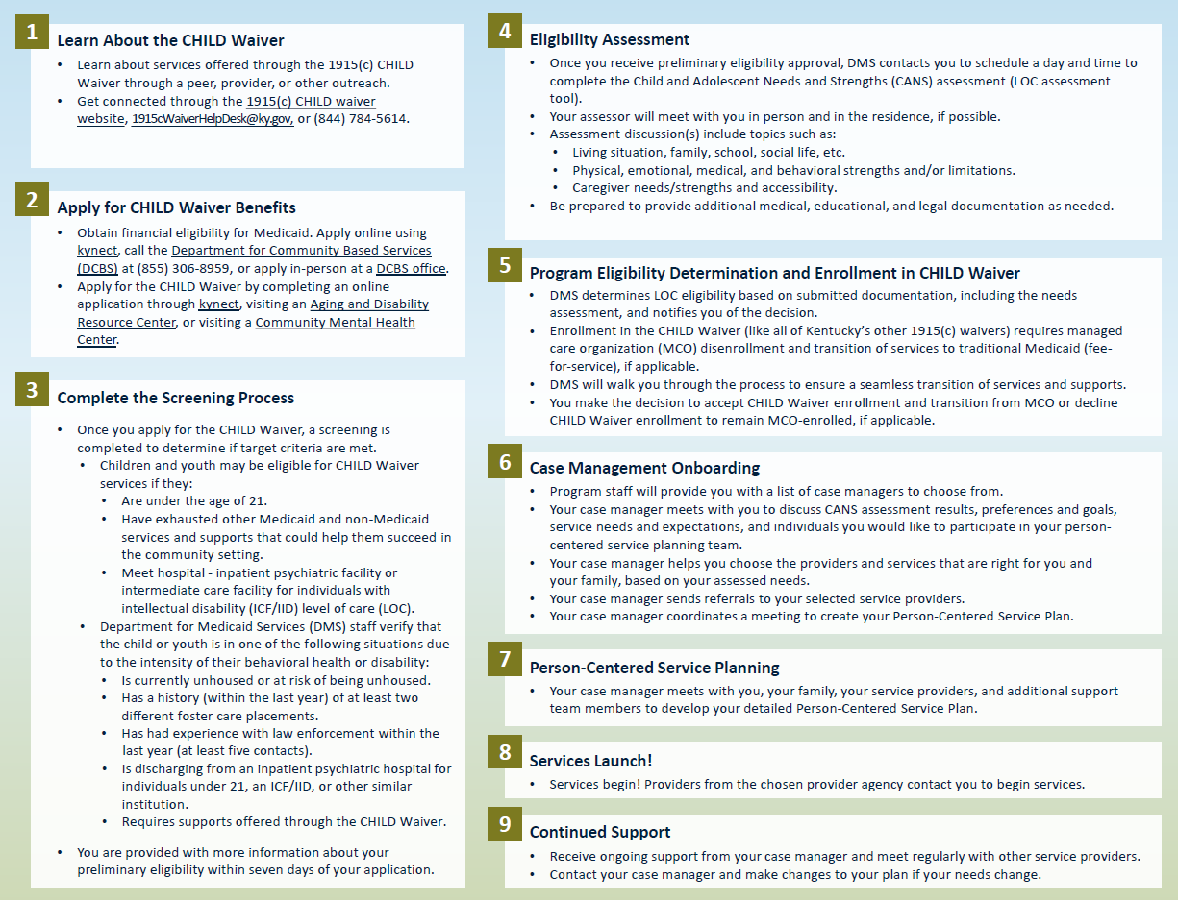
Participant Application Process

Slide 37
Current Updates
DMS received CMS approval for the CHILD waiver on November 6, 2025
Provider outreach, enrollment, and training are underway!
New Provider Orientation Session was held on December 16th, with over 100 people in attendance.
Services to begin early 2026

Slide 38
Provider Resources
1915c Waiver Helpdesk: 1915cwaiverhelpdesk@ky.gov or 844-784-5614
Cabinet for Health and Family Services Website: https://www.chfs.ky.gov
CHILD Waiver Website: chfs.ky.gov/agencies/dms/dca/Pages/child.aspx
CHILD Waiver Reimbursement: Fee Schedules - Cabinet for Health and Family Services
Regulations:
The 1915(c) CHILD regulations are currently under review and awaiting approval
907 KAR 2:720: CHILD Waiver Program Requirements
907 KAR 2:725 CHILD Waiver Reimbursement
Notes:
​

Slide 39
TEAMKY 1115 Update

Slide 40
TEAMKY 1115 Approval
Kentucky received approval on December 12, 2024 for the following Demonstration components:
TEAMKY Section 1115 Demonstration
(Project Number 11-W-00306/4)
Substance Use Disorder (SUD) 1115 Extension
Reentry 1115 Extension
Health Related Social Needs (HRSN) 1115
Recuperative Care Pilot
Serious Mental Illness (SMI) 1115
Out of State Former Foster Care Youth Extension
Recovery Residence Support Service (RRSS)
TEAMKY is approved through December 31, 2029
40
Notes:
Section 1115 Demonstrations are pilot or demonstration projects that promote objectives of the Medicaid program and give states flexibility to design and improve its programs.
1115 Projects focus on evidence-based interventions that drive quality and better health outcomes.
Kentucky’s Section 1115 Demonstration entitled “TEAMKY (formally known as Kentucky Helping to Engage and Achieve Long Term Health (KY HEALTH))” was approved January 2018.
There are several projects under TEAMKY which includes:
KY’s Reentry Section 1115 recently approved July 2024. The Reentry 1115 allows
Medicaid coverage for certain services to justice involved individuals in state prisons and youth development centers to ensure continuity of health care coverage pre- and post-release and to address medical, behavioral health and health related social needs upon release.
KY’s Substance Use Disorder (SUD) Section 1115 was approved in 2018 and implemented 2019 – the extension of the Demonstration is pending with CMS and hopeful to be approved by the end of the year. The SUD 1115
Allows reimbursement up to a statewide average length of stay of 30 days for SUD residential treatment services, and
Waives the Institution for Mental Disease (IMD) Exclusion to allow reimbursement for up to 96 beds​ for programs that meet qualifications and standards required under Demonstration milestones.
With the initial 1115 approval in 2018, KY was approved to Extend Medicaid eligibility to FFCY who are the age of 18 to 26, and were in foster care under the responsibility of another state. This extension is too pending with CMS with hopeful approval by the end of the year.
As a companion to the 1915 I State Plan Amendment request, in May of 2023, KY submitted a request for a Serious Mental Illness (SMI) Section 1115 Demonstration which would allow
Reimbursement up to a statewide average length of stay of 30 days for inpatient treatment adults with serious mental illness (SMI).
KY anticipates receiving this approval with the extension requests by the end of the year.
Also With the May 2023 TEAMKY amendment , DMS included a request to pilot a Recuperative Care service, also known as Medical respite. KY requested
authority to reimburse for recuperative care services, for adult beneficiaries who are homeless or at risk of homelessness requiring additional medical support and care coordination following a hospital stay.
Another pending request under TEAMKY includes the Recovery Residence Support Service (RRSS)
DMS has requested authority to reimburse up to 90 days for Recovery Residence Support Services (RRSS) for eligible adults with an SUD transitioning to the community under the Reentry demonstration or participating in the Kentucky Behavioral Health Conditional Dismissal Program.
KY is not requesting to reimburse for recovery housing; the request is for developing a service which may be provided by recovery residence that meet established standards and criteria. KY is hopefully to receive this approval along with the extension request and other pending components.

Slide 41
TEAMKY 1115/CAA Section 5121 Timeline
Winter 2025
Dec. 8, 2025
New Provider Types developed for Recuperative Care (RC) and Recovery Residence Supports (RRS). Reentry Systems testing.
Januray 2026
Severe Mental Illness (SMI) 1115 Implementation Plan approved by CMS.
RRSS Provider Webinar
RC Pilot Provider Kick Off
Spring 2026
Ongoing Monioring and Evaulation
Winter 2026
CAA Full Compliance.
Oct. 1, 2025
April 1, 2026
Summer 2026
Dec. 15, 2025
Jan.15, 2026
CAA Phase 3
SMI 1115 Provider Letter sent.
CCA Adult Benefit Plan (ABP) State Plan Amendment (SPA) submitted.
Implementation of:
Reentry
CAA Phase 2
RC Pilot
RRSS
Initial
Reentry Deployment
SMI 1115 Implementation
41

Slide 42
House Resolution 1 (119th Congress)

Slide 43
KY Rural Health Transformation Program (RHTP) Current Status and Next Steps
10/28: Application submitted to Governor’s office for review
11/3: RHTP application submitted
8/31: CHFS Stakeholder RFI Feedback Due
9/24: KY CHFS identifies areas of focus for application
10/17: Draft Application Complete
CMS has indicated that budget discussions will occur before final approvals
10/31: Governor’s office signs off on application
Sep 2025
Oct 2025
Nov 2025
Dec 2025
Jan 2026
10/24: KY CHFS completes internal/external stakeholder engagement as needed
12/31: CMS announces RHTP awards
9/15: CMS releases NOFO
9/30: Optional letter of intent due to CMS
11/5: RHTP application due to CMS
Early Jan: CMS distributes funds for first budget period
9/19 & 9/25: CMS Information Webinars
43

Slide 44
KY RHTP Proposed Initiatives
Five Initiatives
Strategic Goal
Use of Funds
 | Rural Community Hubs for Chronic Care Innovation Reduce obesity and diabetes rate through evidence-based, community-led strategies focused on upstream prevention | Make Rural America Healthy Again, Tech Innovation | A, C, D, E, F, G, I, J, K
 | PoWERing Maternal and Infant Health: Community-based Teams Increase timely perinatal care in maternity care deserts through coordinated, telehealth-enabled teams | Sustainable Access | A, B, C, D, E, F, G, H, I, K
 | Rapid Response to Recovery: EmPATH Model, Mobile Crisis and Telehealth Expand integrated, technology-enabled crisis care from community response to long-term support | Innovative Care | D, E, F, G, H, I, J, K
 | Rooted in Health: Rural Dental Access Program Improve rural access to preventive dental care and treatment through expanded training and mobile portable services | Workforce Development | A, B, D, E, F, G, I, J, K
 | From Crisis to Care: Integrated EMS and Trauma Response Strengthen capabilities and capacity for pre-hospital care and in-place interventions | Sustainable Access | A, B, D, E, F, G, K
1
2
3
4
5
44

Slide 45
Eligibility Changes
October 1, 2026: Eligibility changes for immigrants.
December 31, 2026: Work/Community engagement requirements and 6-month redeterminations for expansion population
January 1, 2027: Retroactive coverage limits of one month for expansion and two months for all other groups
October 1, 2028: Cost sharing for expansion adults.
45

Slide 46

46

Slide 47



Open call for topics of interest!
What would you like to hear more about from the Cabinet?

